Slide 1

Chapter 8
Address Resolution
Protocol (ARP)
Copyright © The McGraw-Hill Companies, Inc. Permission required for reproduction or display.

Slide 2
OBJECTIVES:
To make a distinction between logical address (IP address) and physical address (MAC address).
To describe how the mapping of a logical address to a physical address can be static or dynamic.
To show how the address resolution protocol (ARP) is used to dynamically map a logical address to a physical address.
To show that the proxy ARP can be used to create a subnetting effect.
To discuss ATMARP, which maps the IP addresses when the underlying network is an ATM WAN.

Slide 3
Chapter Outline
8.1 Address Mapping
8.2 The ARP Protocol
8.3 ATM ARP
8.4 ARP Package

Slide 4
8-1 ADDRESS MAPPING
The delivery of a packet to a host or a router requires two levels of addressing: logical and physical. We need to be able to map a logical address to its corresponding physical address and vice versa. These can be done using either static or dynamic mapping.

Slide 5
Topics Discussed in the Section
Static Mapping
Dynamic Mapping

Slide 6
8-2 ADDRESS MAPPING
Anytime a host or a router has an IP datagram to send to another host or router, it has the logical (IP) address of the receiver. But the IP datagram must be encapsulated in a frame to be able to pass through the physical network.
A mapping corresponds a logical address to a physical address. ARP accepts a logical address from the IP protocol, maps the address to the corresponding physical address and pass it to the data link layer.

Slide 7
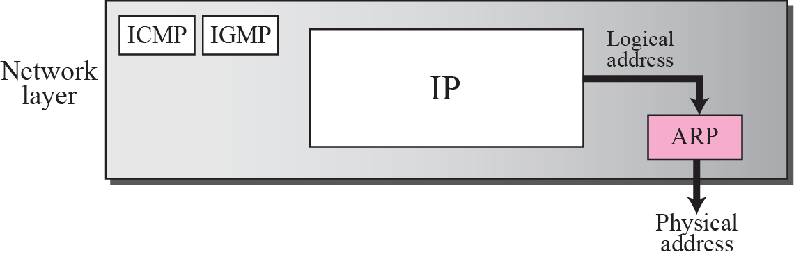
Figure 8.1 Position of ARP in TCP/IP protocol suite

Slide 8
Figure 8.2 ARP operation
broadcast

Slide 9
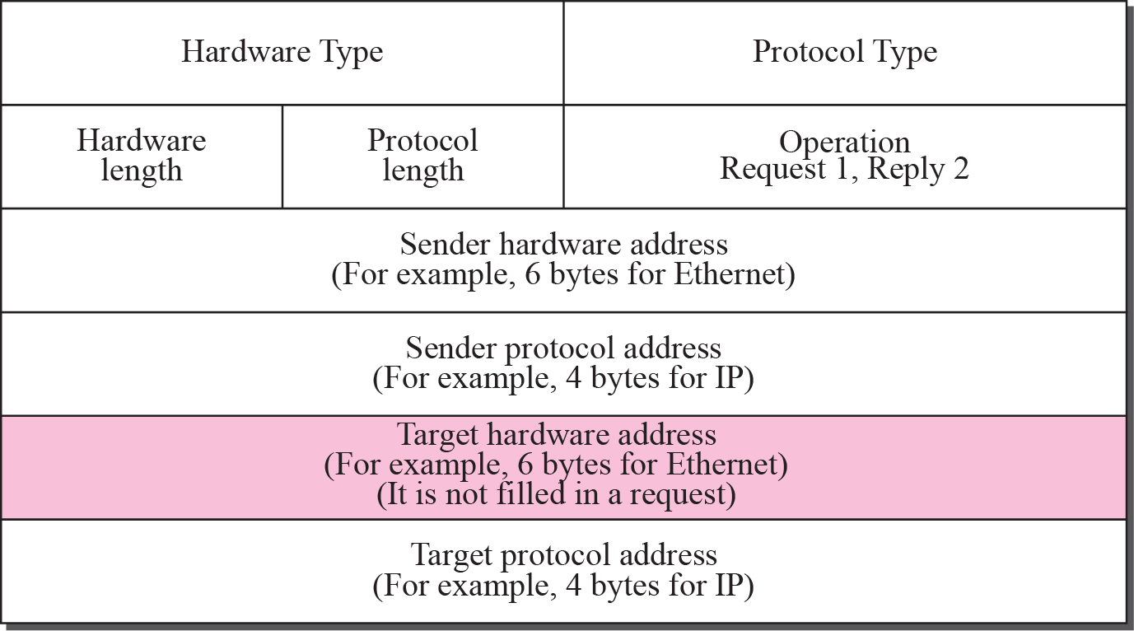
Figure 8.3 ARP packet

Slide 10
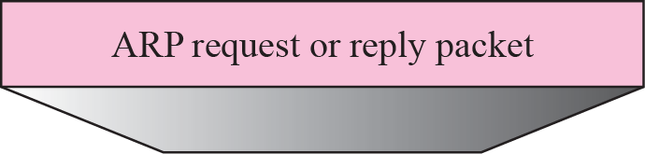
Figure 8.4 Encapsulation of ARP packet

Slide 11

Note
An ARP request is broadcast; an ARP reply is unicast.

Slide 12
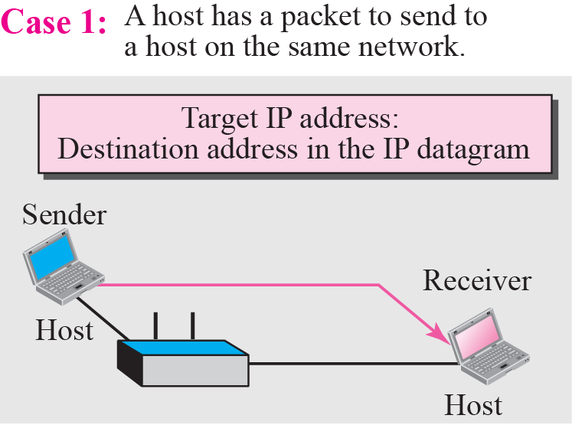
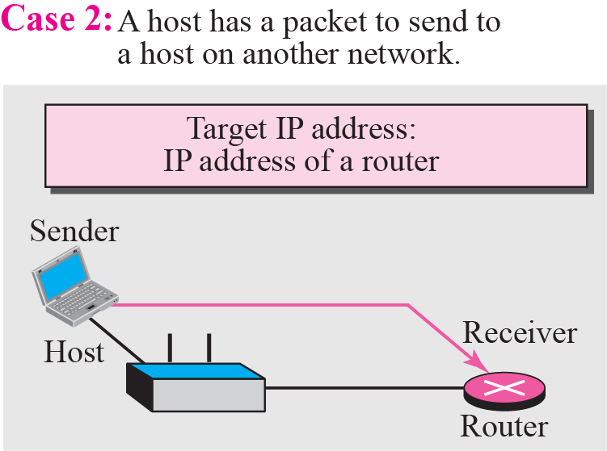
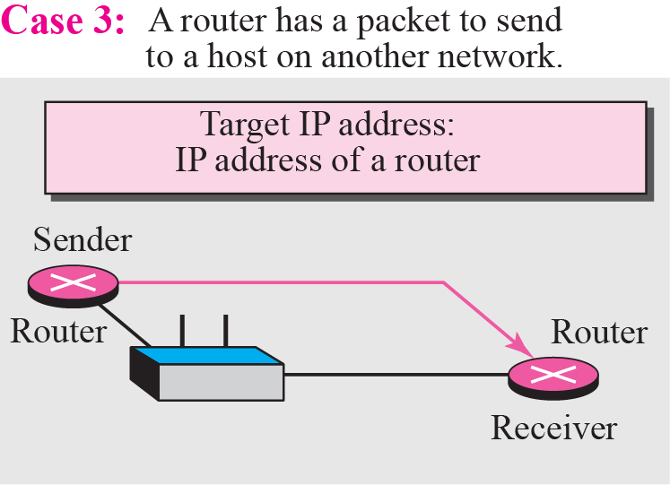
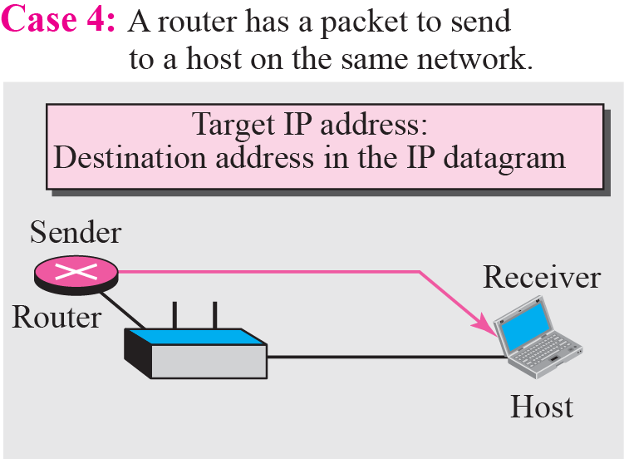
Figure 8.5 Four cases using ARP

Slide 13
用户输入命令“ftp 主机名”时的操作
主机名
主机名
目的
解析器
（1）
FTP
FTP
IP地址
（2）
TCP
TCP
（3）
（4）
IP
IP
ARP
ARP
ARP
（5）
（7）
（6）
以太网
驱动程序
以太网
驱动程序
以太网
驱动程序

Slide 14
IP Packet and ARP Packet
A
B
No binding
IP packet
ARP request
IP packet
IP packet
ARP reply
Binding A
IP
IP
Binding B
IP
IP packet
IP

Slide 15
Example
A host with IP address 130.23.43.20 and physical address 0xB23455102210 has a packet to send to another host with IP address 130.23.43.25 and physical address 0xA46EF45983AB. The two hosts are on the same Ethernet network. Show the ARP request and reply packets encapsulated in Ethernet frames.

Slide 16
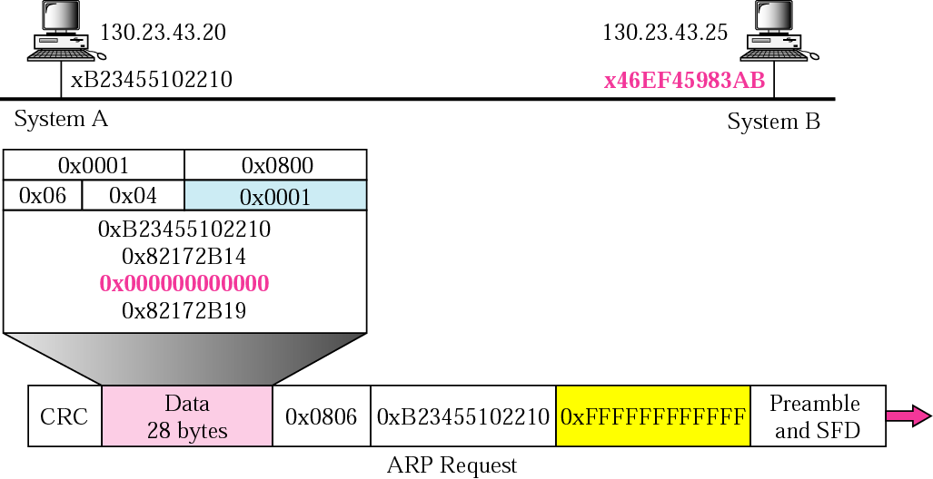
Example: ARP Request

Slide 17
Example: ARP Request

Slide 18
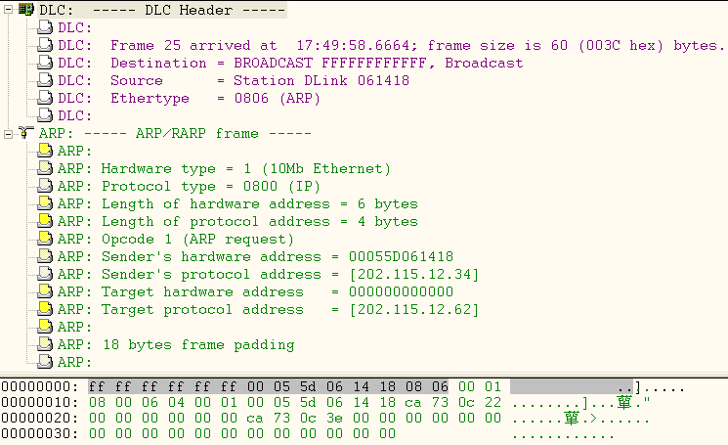
Example: ARP Request Packet

Slide 19
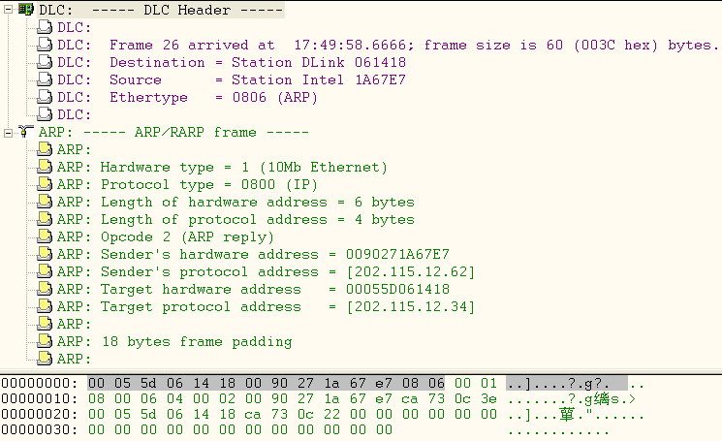
Example: ARP Reply Packet

Slide 20
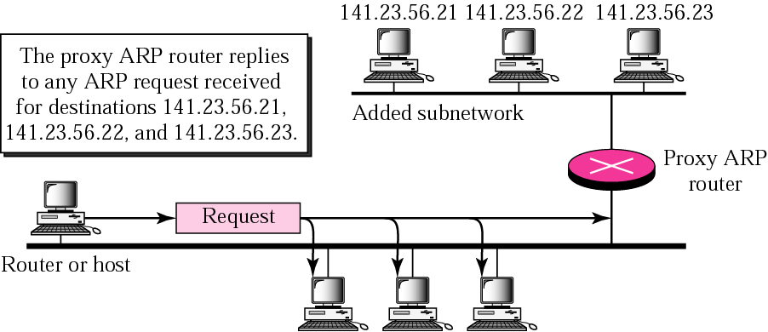
Proxy ARP
“Honest”
Hided
Q: In the same IP network or not?
Notes:
代理ARP

Slide 21
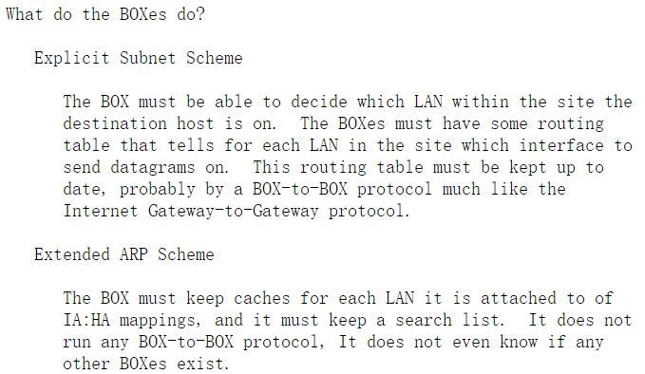
Answer
RFC 925: Multi-LAN Address Resolution
Explicit subnets
Transparent subnets（Extended ARP）
Notes:
显式子网 透明子网 RFC925: The new element is the "magic box" ("ARP-based bridge") that relays the ARP request into neighboring LANs and acts as an agent for relaying datagrams to hosts on other LANs. The host must be able to decide if this IA is on this LAN or some other LAN. If on this LAN then use some procedure to find the HA. If on some other LAN then use some procedure to find the HA of a BOX.

Slide 22
Answer
RFC 1027: Using ARP to Implement Transparent Subnet Gateways
Routers: Explicit subnets
Hosts: Transparent subnets
“ From the host point of view, there are no subnets, and their physical networks are simply one big IP network. ”
Notes:
RFC-925 describes a general mechanism for dynamic subnet routing using Proxy ARP and routing caches in the gateways. Our technique is restricted subset of RFC-925, in which we use static subnet routes which are determined administratively. As a result, our transparent subnet gateways require no new network routing table entries nor ARP cache entries; the only tables which are affected are the ARP caches in the host

Slide 23
RFC 1027 Discussion
.33
.34
.35
.1/27
R
.62/27
.3
.4
.5
Solution：
R代替.35向.3返回ARP应答
—— Proxy ARP
200.6.8.32/27
Hided network
200.6.8.0/24
Main network
.3向.35发送IP分组
.3广播请求.35的ARP分组，R不转发广播
.35向.3发送IP分组
.35广播请求.62的ARP分组
→ IP发送失败
→ ARP失败
→ IP发送成功
→ ARP成功
Notes:
In our implementation, routing loops are prevented by proper administration of the subnet routing tables in the gateways.

Slide 24
Gratuitous ARP
W. Stevens: 《TCP/IP Illustrated Volume 1: The Protocol》
Duplicate address test
A
202.115.12.34
2. ARP reply:
sIP = tIP = 202.115.12.34
1. ARP request: sIP = tIP = 202.115.12.34
202.115.12.34
B
3. Disable local interface: 202.115.12.34
Startup or
Change IP address
Notes:
免费/无故的 ARP，可以有两个方面的作用：1) 一个主机可以通过它来确定另一个主机是否设置了相同的I P地址；2) 如果发送免费ARP的主机正好改变了硬件地址（很可能是主机关机了，并换了一块接口卡，然后重新启动），那么这个分组就可以使其他主机高速缓存中旧的硬件地址进行相应的更新。

Slide 25
Chapter Outline
8.1 Address Mapping
8.2 The ARP Protocol
8.3 ATM ARP
8.4 ARP Package

Slide 26
8-3 ATM ARP
When IP packet are moving through an ATMWAN, a mechanism protocol is needed to find (map) the physical address of the exiting-point router in the ATM WAN given the IP address of the router.
This is the same task performed by ARP on a LAN. However, there is a difference between a LAN and an ATM network. A LAN is a broadcast network (at the data link layer); ARP uses the broadcasting capability of a LAN to send (broadcast) an ARP request.

Slide 27
Topics Discussed in the Section
Packet Format
ATMARP Operation
Logical IP Subnet (LIS)

Slide 28
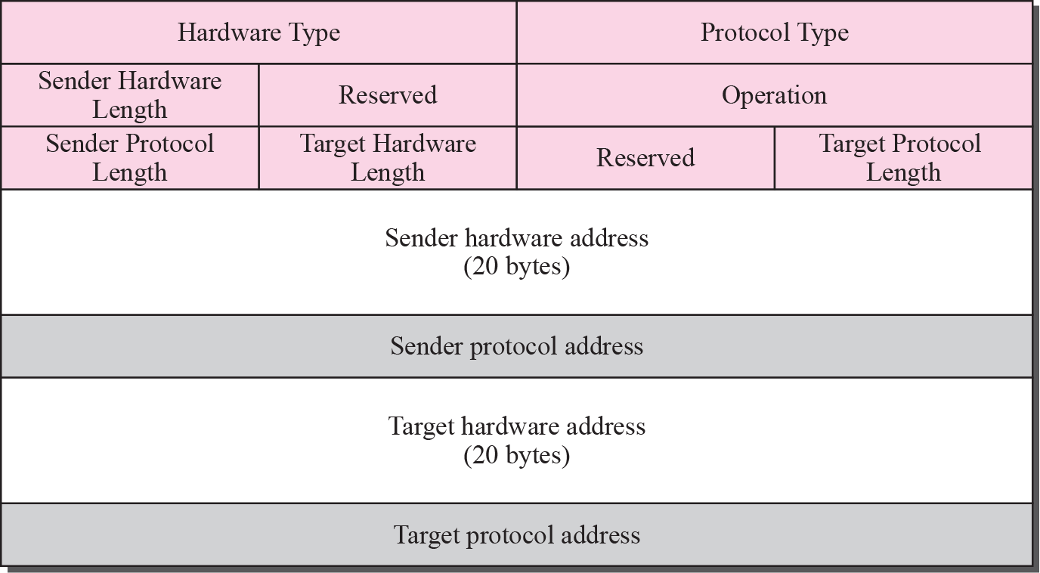
Figure 8.8 ATMARP packet

Slide 30
Note
The inverse request and inverse reply messages can bind the physical address to an IP address in a PVC situation.

Slide 31
Figure 8.9 Binding with PVC

Slide 32
Figure 8.10 Binding with ATMARP
Finding physical
address

Slide 33
Note
The request and reply message can be used to bind a physical address to an
IP address in an SVC situation.

Slide 34
Note
The inverse request and inverse reply can also be used to build the server’s mapping table.

Slide 35
Figure 8.11 Building a table

Slide 36
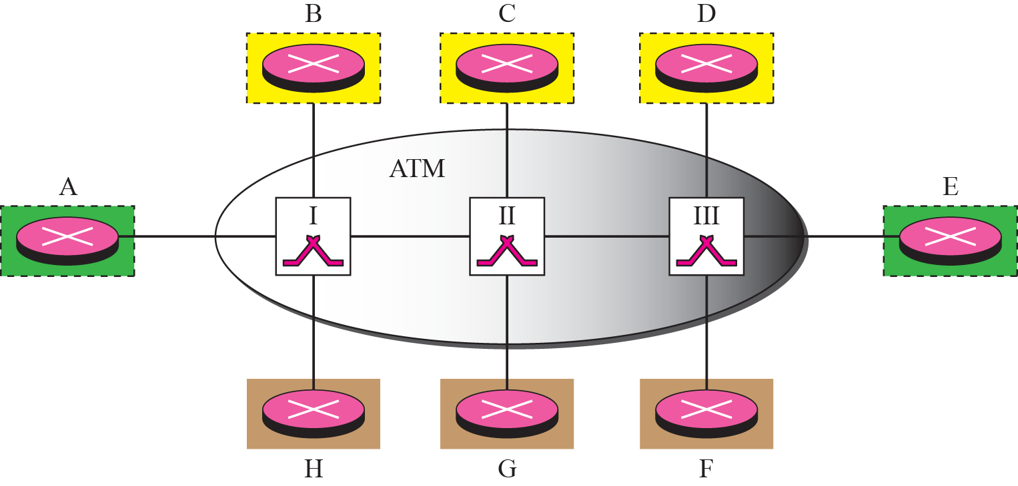
Figure 8.12 LIS

Slide 37
Note
LIS allows an ATM network to be divided into several logical subnets.
To use ATMARP, we need a separate server for each subnet.

Slide 38
8-4 ARP PACKAGE
In this section, we give an example of a simplified ARP software package. The purpose is to show the components of a hypothetical ARP package and the relationships between the components. Figure 8.13 shows these components and their interactions.
We can say that this ARP package involves five components: a cache table, queues, an output module, an input module, and a cache-control module.

Slide 39
Chapter Outline
8.1 Address Mapping
8.2 The ARP Protocol
8.3 ATM ARP
8.4 ARP Package

Slide 40
Topics Discussed in the Section
Cache Table
Queues
Output Module
Input Module
Cache-Control Module

Slide 41
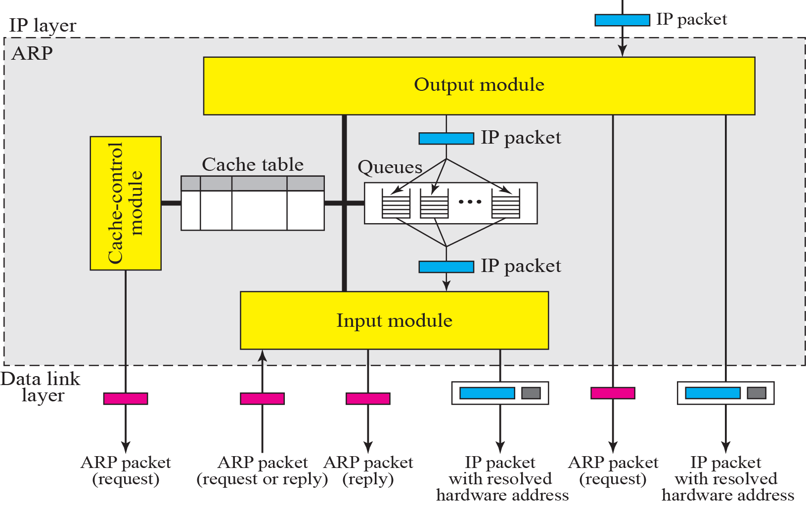
Figure 8.13 ARP components

Slide 42
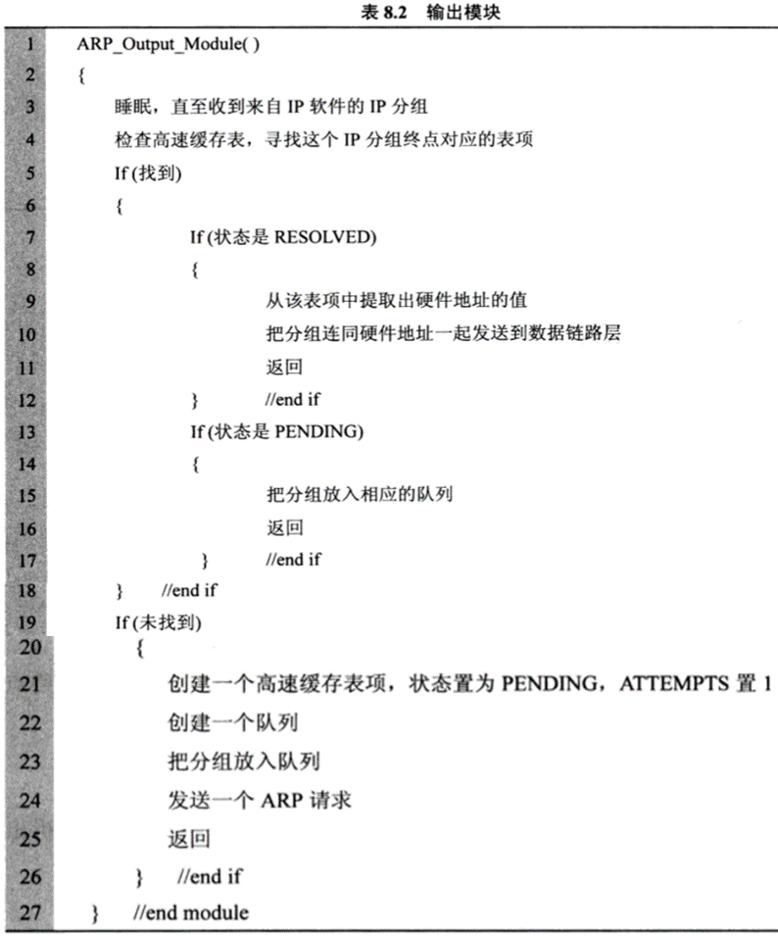

Slide 43
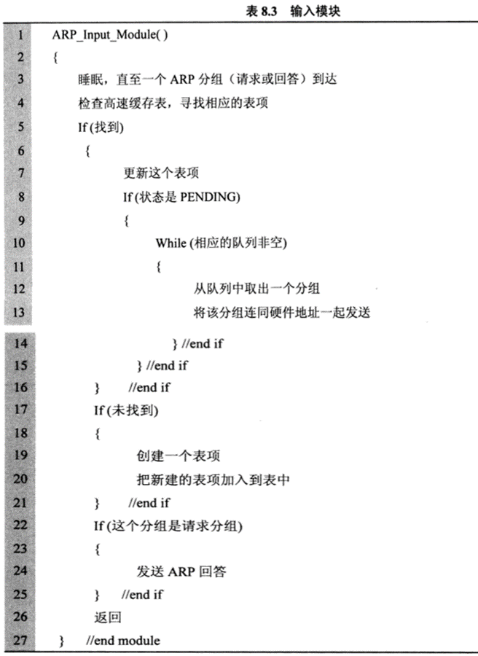

Slide 44
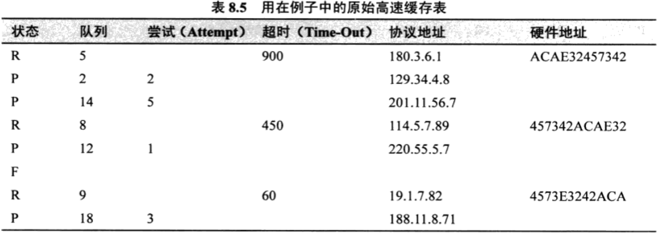
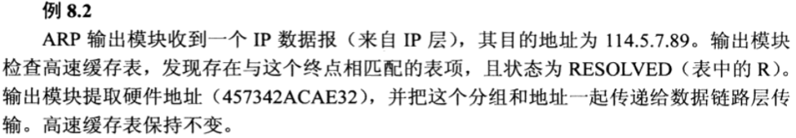
ARP Package
高速缓存表例子
Notes:
未分配物理地址的分组

Slide 45
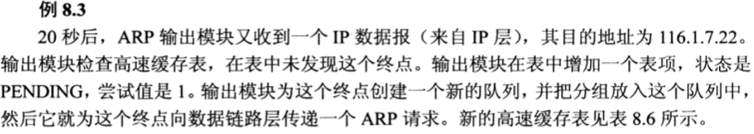
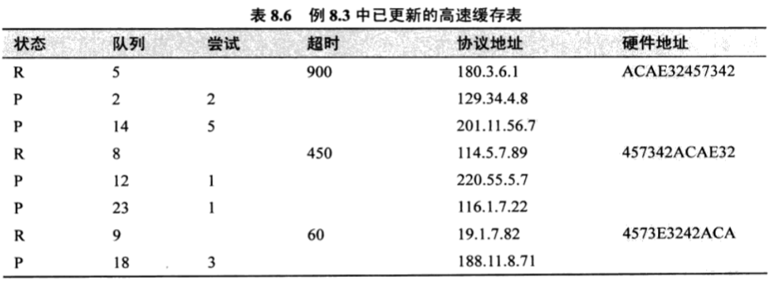
ARP Package
高速缓存表例子
Notes:
未分配物理地址的分组

Slide 46
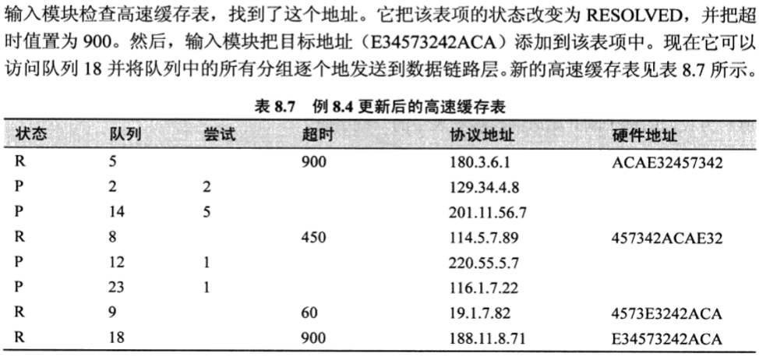
ARP Package
高速缓存表例子
Notes:
未分配物理地址的分组

Slide 47
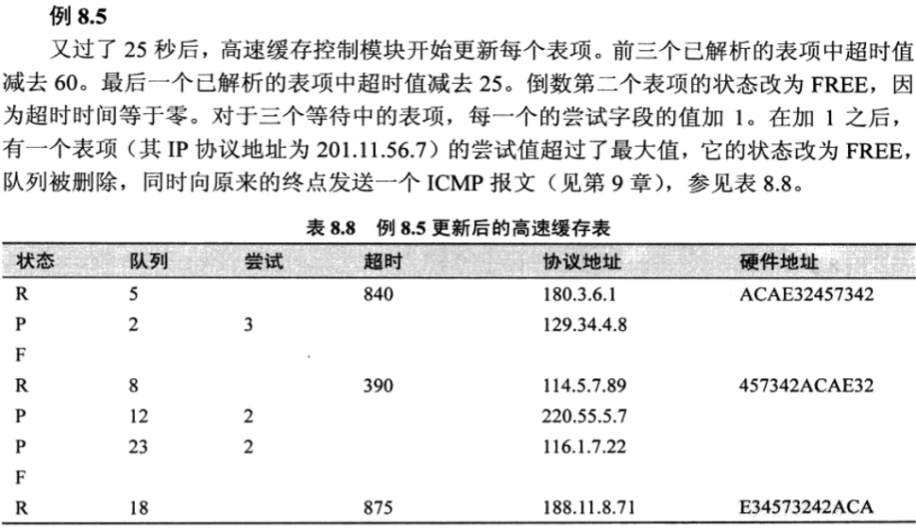
ARP Package
高速缓存表例子
Notes:
未分配物理地址的分组

Slide 48
ARP Cache
Host（Windows XP）
Router（Cisco）
C:\> arp –a
Interface: 202.115.12.34 --- 0x2
Internet Address Physical Address Type
202.115.12.33 00-90-27-a7-98-41 dynamic
202.115.12.47 00-90-27-1d-d9-94 dynamic
202.115.12.62 00-90-27-1a-67-e7 dynamic
Router# show arp
Protocol Address Age (min) Hardware Addr Type Interface
Internet 202.115.12.33 -- 0090.27a7.9841 ARPA Ethernet0
Internet 202.115.12.34 5 0005.5d06.1418 ARPA Ethernet0
Internet 202.115.13.1 -- 00e0.7bc0.b205 ARPA Ethernet1
Notes:
此处是ARP cache，前面是ARP软件包中的缓存表

Slide 49
RFC References
RFC 1122: Requirements for Internet Hosts -- Communication Layers
Section 2.3.2: ARP cache, ARP packet queue
RFC 1812: Requirements for IPv4 Routers
Section 3.3.2
RFC 1433: Directed ARP
ARP helper address
RFC 1868: ARP Extension – UNARP
Announce leaving

Slide 50
Thanks

